Slide 1
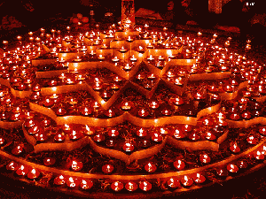
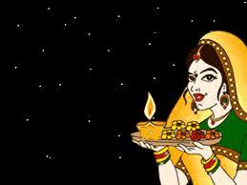
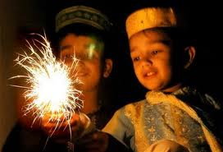
Diwali
The Hindu festival of lights

Slide 2
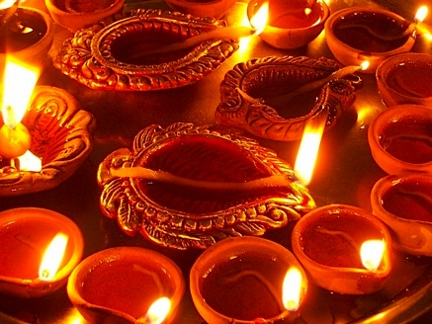
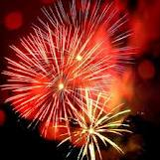
Diwali’s History
> Diwali’s was first celebrated thousands of years ago in India.
> It was celebrated because Vishnu, there god gave them a festival for their harvest.
> All Hindus celebrate Diwali.

Slide 3
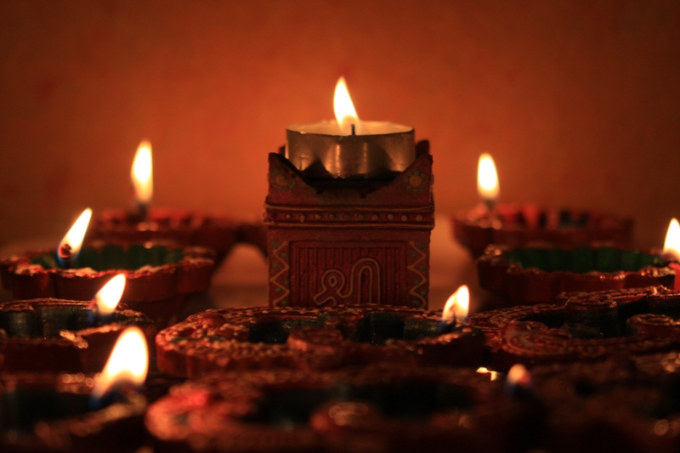
Hindus and Hinduism
Diwali is a very important to many Hindus.
The name Diwali comes from a Sanskrit word dipavali.
Dipavali means row of lights.
They believe that everybody has a soul called Atman.
Diwali is the most important festival in India.

Slide 4
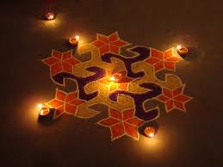
Preparation for Diwali
$ Restaurants prepare for Diwali by making Indian foods.
$ People pray at temples or at their homes
$ Many people wear gold jewelry during Diwali festivals
$ During Diwali, woman wear fancy Indian dresses called saris

Slide 5
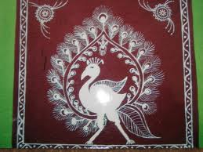
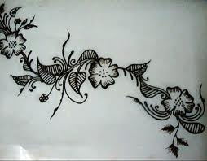
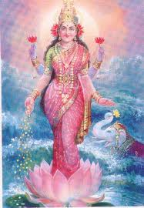
Diwali Has Arrived!!
Henna paintings are a fun activity for women and children
Henna is a plant
Rangoli is similar to henna paintings but has more color and is meant for doors, houses, buildings, and shops
Lakshmi Puja is performed on the night of Diwali
Prayers are said, candles are lit, and songs are sung

