Slide 1
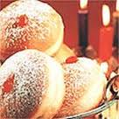
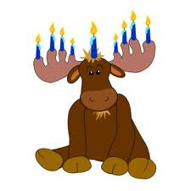
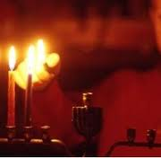
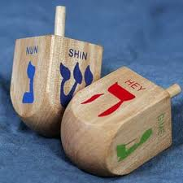
Hanukkah
History
Celebration

Slide 2
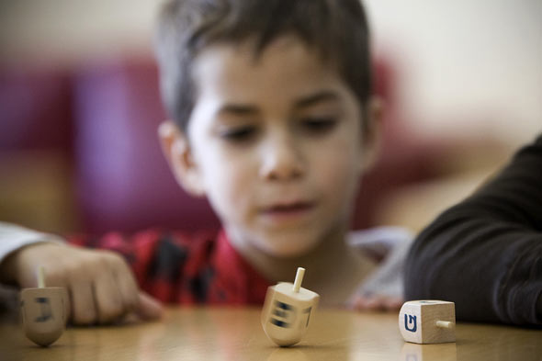
GIFTS,GAMES,AND FOODS
Gifts, people love to give gifts, most of them are homemade. Some gifts can be passed down from family to family.
Games most games Jewish people play is…………….. Drum roll please……dreidel!!!!!!☺☺
FOODS the foods Jewish eat are latkes, (a potato pancakes) sufaganiyot (a jelly doughnuts).

Slide 3
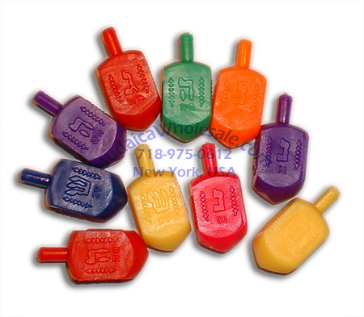
DREIDELS
The most famous game people like to play is dreidel. Dreidels are like a top. They have four sides with Hebrew letters. The letters stand for Nes, Gadol, Hayah, Sham. As much as we like dreidels they can become a very hard game.

Slide 4
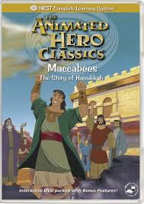
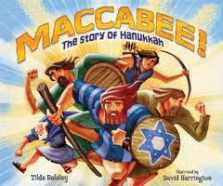
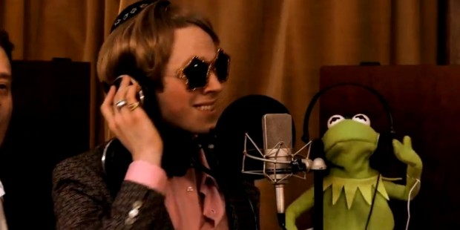
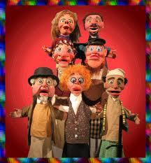
The Maccabees
The Maccabees were a religious group of people that fought against the greeks for their religion. The Maccabees were excellent fighters. They once beat a group of greeks when they were out numbered.

Slide 5
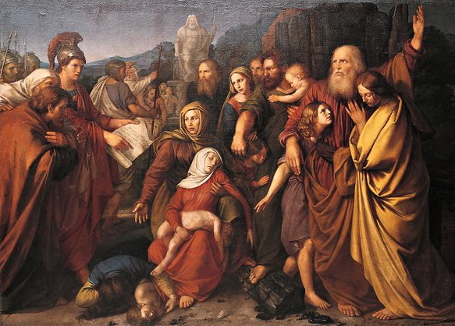
How Hanukah became a holiday.
When the Maccabees defeated the greeks they hurried to the temple and made sure that they had oil to fill the eternal light. Unfortunately they did not have enough oil to last a long time. Fortunately they did not know that it would last eight days and eight nights!
The Jews celebrate Hanukah because of the eight days and nights that the eternal light burned.

Slide 6
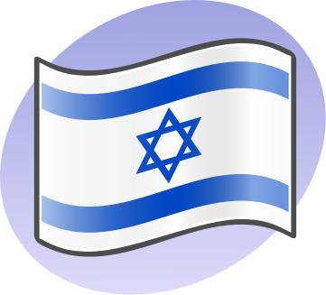
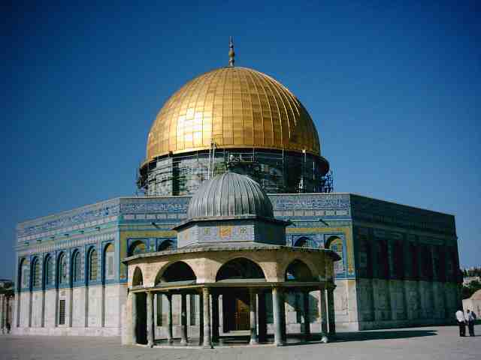
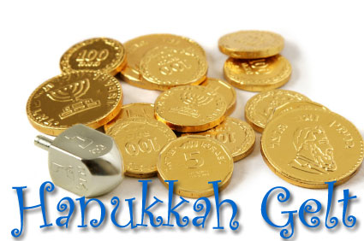
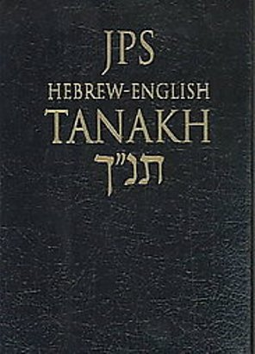
Religion and The Jewish people
The Jewish religion is called Judaism. Jewish call the place were they pray a Temple.
There are over 14 million Jewish people in the world. Most
Jews live in a place called Israel and their official language is Hebrew.

Slide 7
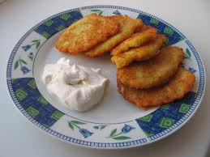
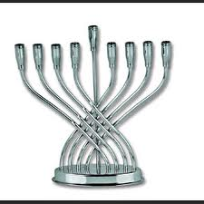
Prayers
The Shamash is the middle candle in the menorah, it is very special. They light all the other candles with the shamash candle. Lighting the candle is done in a special way they always light the candle to the farthest right. Latkes are a potato pancakes dipped oil and potatos boiled with them. A prayer is said every night while lighting the candles.

