Slide 1
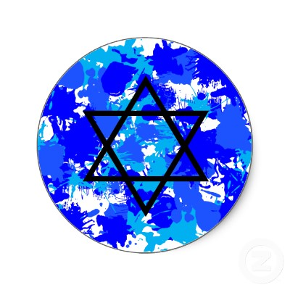
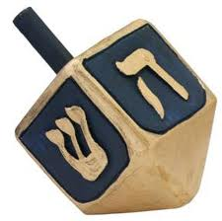
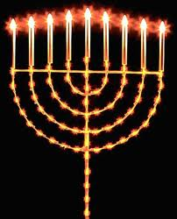
Hanukkah
Group #3

Slide 2
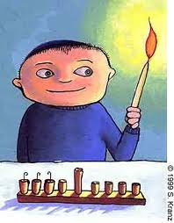
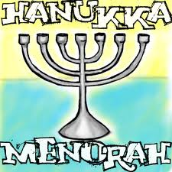
A Very Happy Holiday
Jewish People
Very Happy Holiday
Twentieth
Menorah
Shamash
Hanukkah

Slide 3
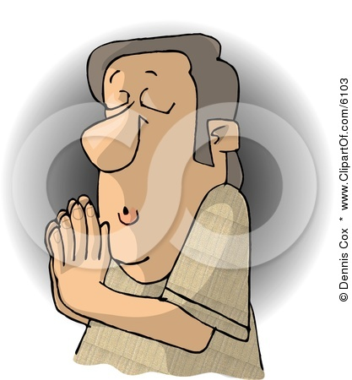
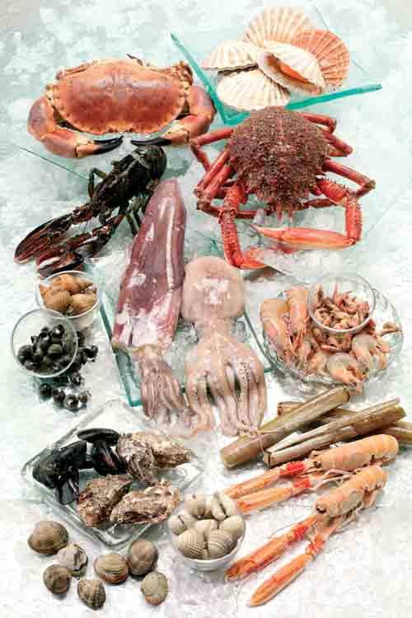
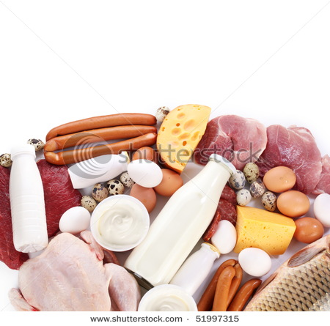
Jewish people
They don’t eat pork or shellfish.
They DON’T eat meat with dairy.
Some Jews don’t work, drive, use electricity
or spend money on sabbath.
Jews have 1 god and follow the hebrew bible

Slide 4
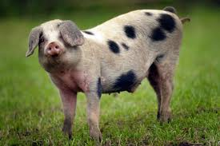
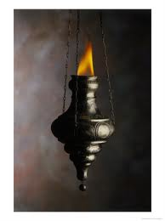
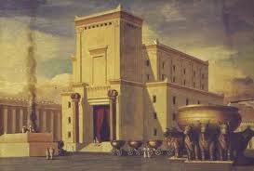
History of Hanukkah
Isrial
The temple
The special oil
Idols
King Antiochus the fourth
Mattias and the pig
Maccabees
Eight days

Slide 5
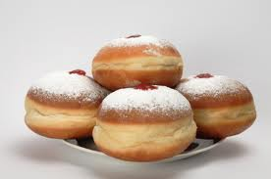
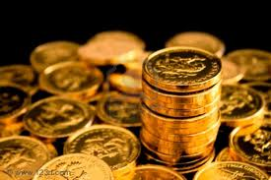
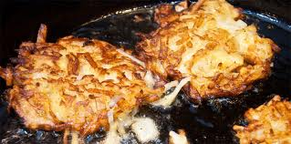
Jewish foods and games
Latkes
Sufganiyots
Dreidle
Gambling
Gelt
Chocolate Money

