Slide 1
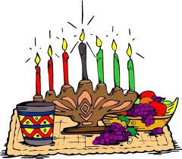
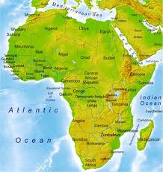
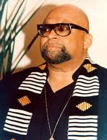
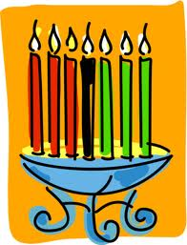
Kwanzaa
Michael, Jesse, Anissa, Chloe

Slide 2
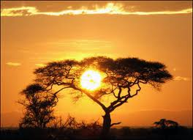
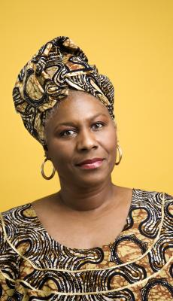
Heri Za Kwanzaa!
Days short
Nights are very long
Return of the sun
African Americans Celbrate it
Clothing and hair

Slide 3
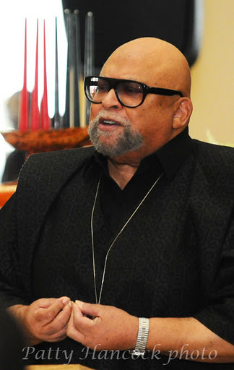
A Brand-New Day!
Holiday invented by Dr. Karenga
Dr. Karenga teaches at CSU
Creating Kwanzaa
Organized believes

Slide 4
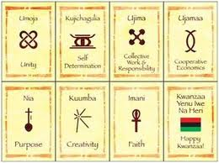
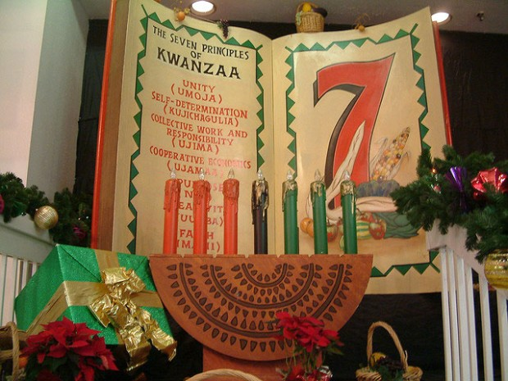
SEVEN PRINCIPAL OF KWANZAA
Day 1 Umaja- unity
Day 2 Kujichagulia- self determation
Day 3 Ujima – collective sord and resoponsibity
Day 4 Ujamaa – cooperation
Day 5 Nia- purpose
Day 6 Kaumba- creativity
Day 7 Imani- faith

Slide 5
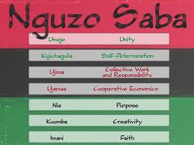
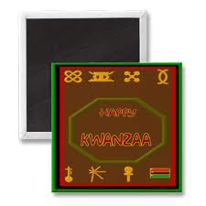
7 Kwanzaa symbols
1 Mkeka or mat
2 Mazao or fruits & veggies
3 Kikonbe cha umoja or unity cup
4 Muhindi, corn
5 Kinara, or candle holder
6 Mishumaa saba
7 Zawadi, or gifts

Slide 6
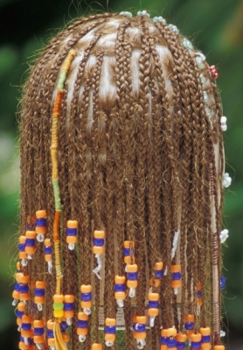
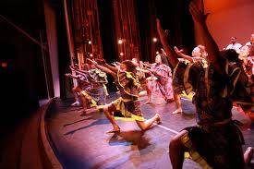
Habari Gani? Umoja!
December 26
Umoja night
Harambee!
Hair they braid
Dr. Martin Luther
Big feasts

Slide 7
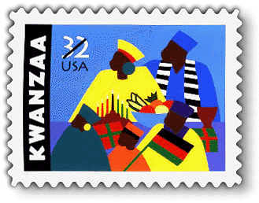
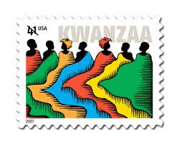
Kwanzaa
Cal.
First Harvest
THE END

Slide 8
CREDITS
Michael
JESSE
ANISSA
CHLOE

